Slide 1




Web Analytics Final Project (Group 13)
By: Marcos Sanson, Kelvin Martinez, Tapanga Witt

Slide 2



Project Idea
Create a network and career-growth platform for students and recent graduates
Offers personalized job matches and tracks application history
Provides detailed feedback/advice to help users improve their chances for each applications (skills, keywords, other users related to job)

Slide 3

Goal and Motivation
To encourage students and recent graduates to network
To help students find jobs and opportunities based off their skills and profile
Students struggle with gaining experience related to their major and skills
Helps address the need for students to find relevant jobs and opportunities that fit their studies and skill set

Slide 4



State of the Art
Existing Platforms and APIs:
LinkedIn
Indeed
Glassdoor
Key Features: filter by role, location, experience level; real time data

Slide 5

State of the Art
Data analysis techniques
Natural Language Processing (NLP): Extract skills, keywords, and trends from job descriptions
Example: presence of the word “Python” in engineering job descriptions
Machine Learning: Matches users to jobs; improves recommendations with time

Slide 6
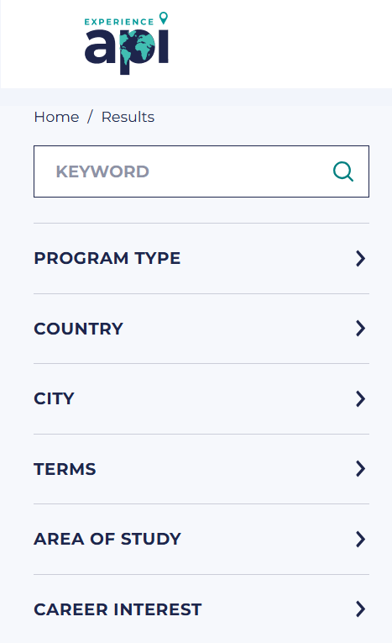
State of the Art
Visualization and Insights
Interactive Dashboards: Customizable filters for users preferences
Company Insights: Salary reports, interview experiences, total job openings
Emerging techniques
Graph Analysis: Modeling relationships between job categories, companies, industries
Chatbots: Guide users, refine search, enhance user engagement

Slide 7


Our Data Source
Adzuna API: It provides real-time job listings
The data includes:
Job title
Location
Salary information
Company
Job description

Slide 8

Data Gathering Techniques
API Requests:
Base url: https://api.adzuna.com/v1/api/jobs
Example of request: gb/search/1?app_id=my_app_id&app_key=my_app_key&results_per_page=50&where=London&what=Engineer
We send a get request to the API
Every time we make a query the response is returned as an object serialized using JSON

Slide 9
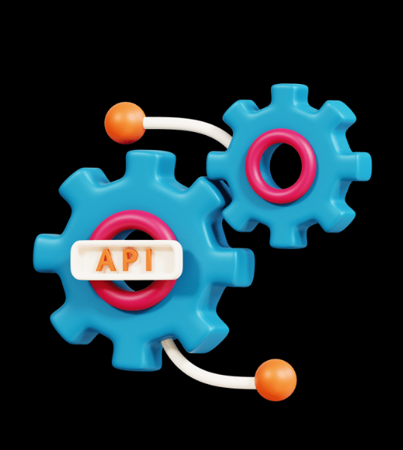
Data Gathering Techniques
How it works:
Base URL: Specifies the endpoint for job data
Query Parameters:
app_id: Your unique application ID
app_key: Your unique API key
results_per_page: Number of job results to retrieve per request
where: Location (e.g., London)
what: Job title or keyword (e.g., Engineer)

Slide 10
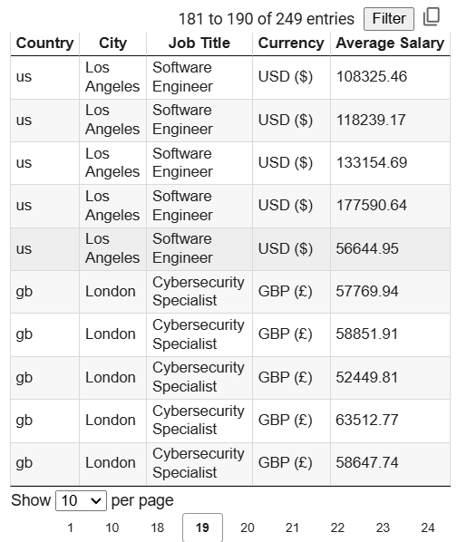
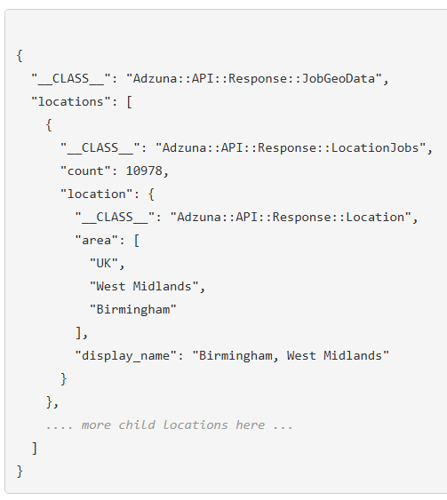
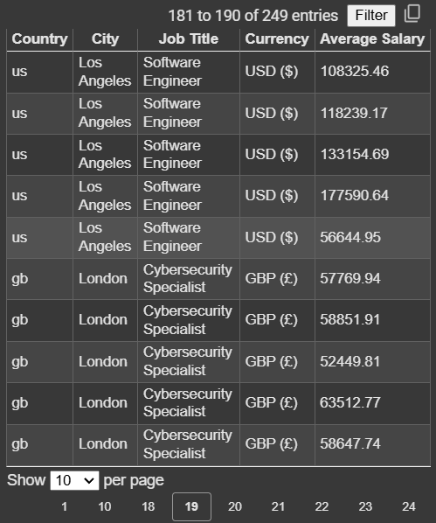
Data Gathering Techniques
Data Processing Workflow
1. Data Extraction:
- Extract the JSON element from the API response for further processing
2. Data Cleaning:
- Handle missing values
- Convert numeric fields (e.g., salaries) to integers or floats for accurate calculations
3. Data Storage:
- Use Pandas to save the cleaned data into CSV files

Slide 11
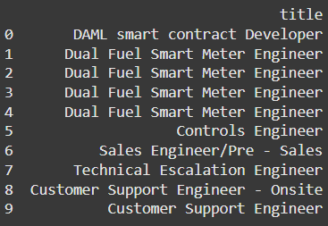
Problems found/Possible issues
API limitation: 1000 requests/hour
Inconsistent Data: Some job listings lack salary information, or latitude and longitude information
API errors: Some errors (error 503) could occur, requiring retries
Presence of duplicates
Jobs offers might not be available for certain regions

Slide 12

Data Analysis Techniques
We used natural language processing (NLP) to calculate a similarity score between the user’s profile and the job description:
We converted the job descriptions and the user’s profile in numerical vectors based on word frequency and importance
Then we compared the vector representing the user’s profile and the job descriptions

Slide 13
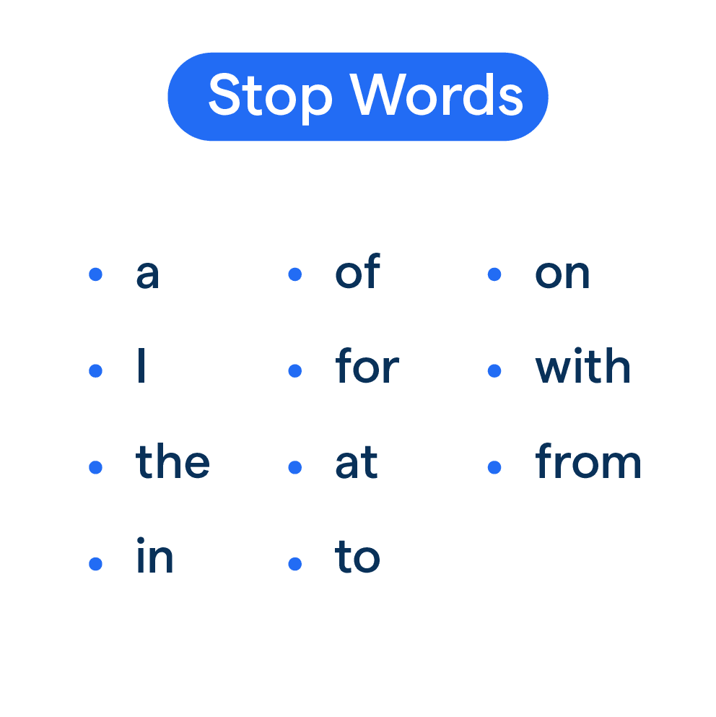
Problems faced/Potential issues
Stop words used for NLP:
This implies that we can only calculate similarity scores for languages of chosen stop words (here English)
Data aggregation:
Careful handling of the dataset to ensure no duplicates or errors and making it appropriate for visualisation

Slide 14
Problems faced/Potential issues
Difficulty to observe long time trends
The only tool given to us by the API is an history feature that returns the salary for given job category and location over a time period
Ex: it-jobs in New-York the response is :
"month": {
"2024-07": 65025.13,
"2024-09": 78193.44,
"2024-03": 71314.31,
"2024-04": 69694.3,
"2024-06": 62789.18,
"2024-10": 78704.29,
"2024-05": 57984.3,
"2024-02": 70137.13,
"2024-11": 75506.25,
"2024-01": 69238.5,
"2024-08": 74562.62,
"2023-12": 70545
},

Slide 15

Data Visualization
We created a Folium map that shows the jobs having the best similarities for a given user
Example for the following user:
user_profile = {
"field": "Data",
"experience": "Senior",
"location": "London",
"min_salary": 30000,
"max_salary": 150000,
"category": "IT Jobs",
"date_posted_within_days": 7
}

Slide 16
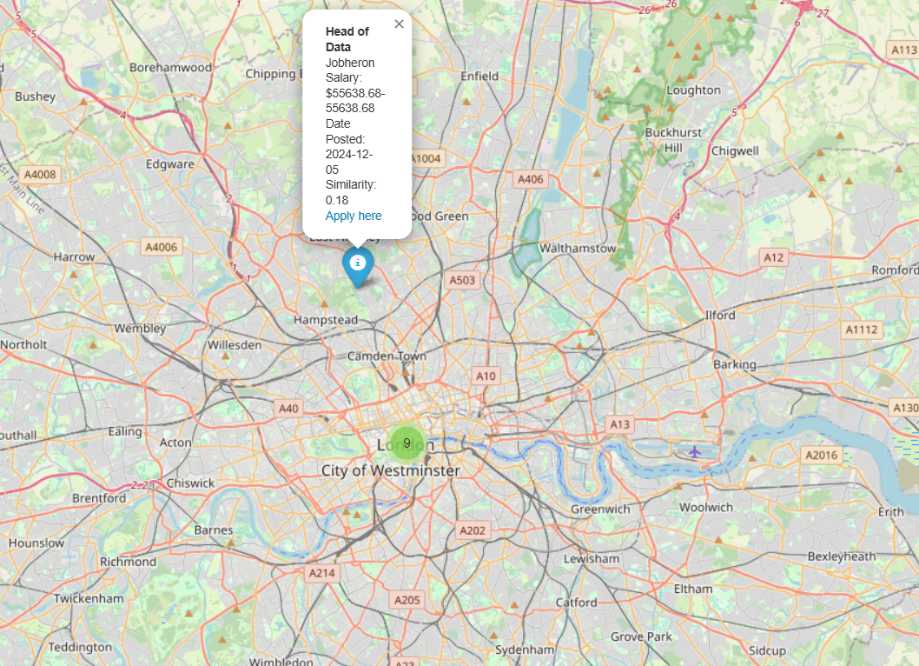
Data Visualization

Slide 17
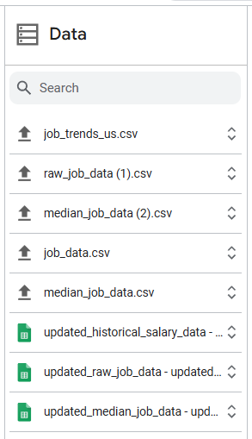
Data Visualization
- Creation of a Google dashboard:
• A barplot to visualize the median salaries for certain job offers in different cities
• A boxplot to visualize the salaries for certain job offers in different cities

Slide 18
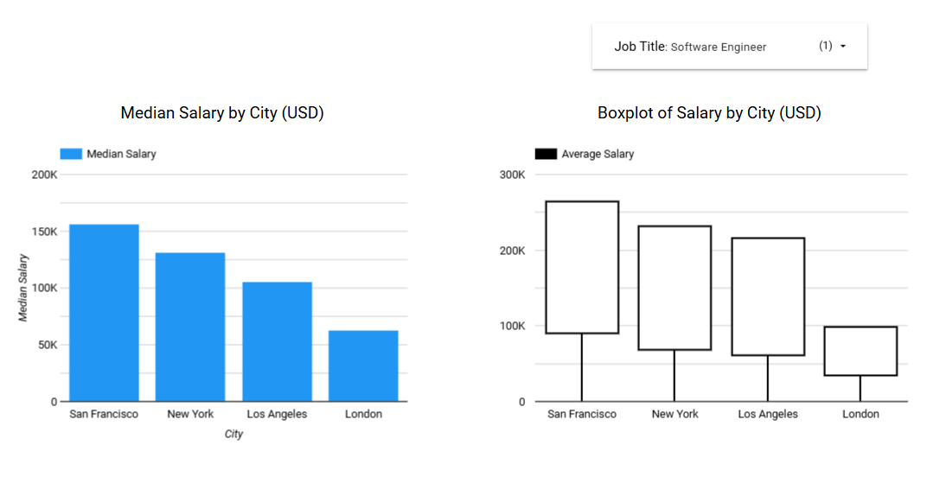
Data Visualization (Software Engineer)

Slide 19
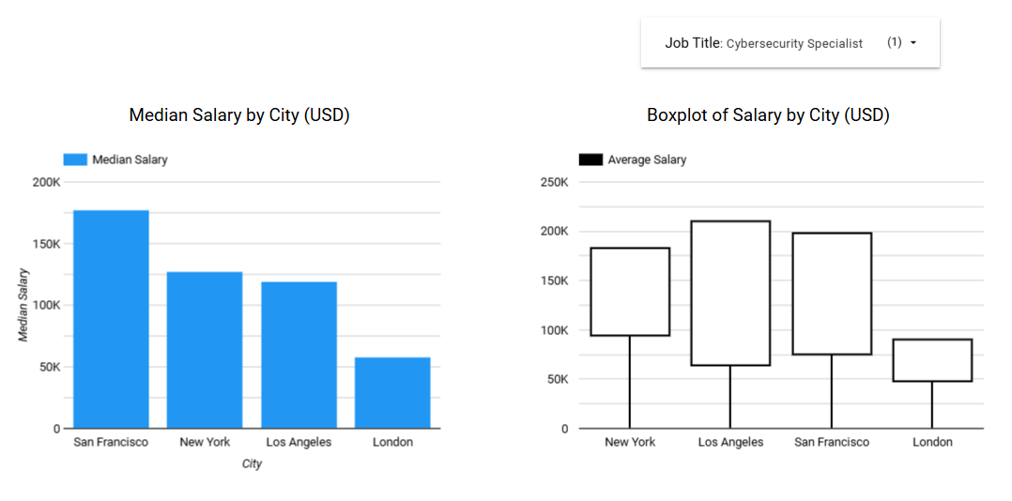
Data Visualization (Cybersecurity Specialist)

Slide 20
Data Visualization
We also created a plot that represents the time evolution of salaries for a given job category and some given location
For example: it-jobs in London and New York

Slide 21
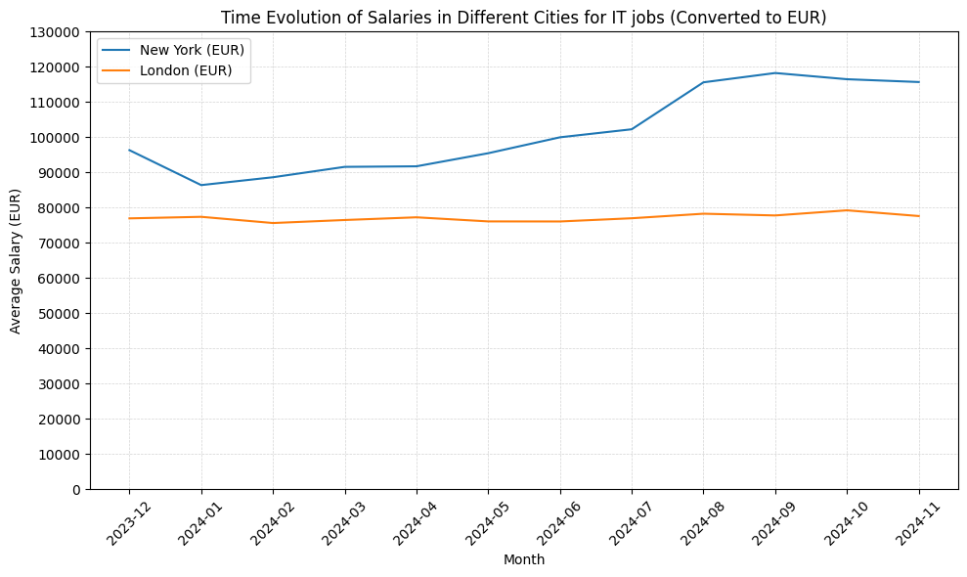
Data Visualization

Slide 22

Did we meet our goals?
Yes, most of them.
A platform that allows user to find the
best job
Provides useful information on jobs
Sadly we don’t have accurate trends over time for a given/specific job or detailed feedback for applicants

Slide 23
Main Takeaways
The salary distribution varies a lot across cities
We can see specific data trends for overall jobs and salaries, which is more clear compared to other state-of-the-art solutions (e.g., LinkedIn)
We also provide exact locations/geographic info
Importance of NLP for job matching
The data gathered provides useful insights for everyday users
See specific locations and salaries

Slide 24
Future Work
Expand data collection
Expand to other countries around the world
Other languages besides English
Incorporate more data sources:
Maybe incorporate data from different APIs
Machine learning
Techniques such as more complex NLP
Personalized job recommendations given a specific prompt

Slide 25

Any questions?

